Slide 1

2025 Toolkit

Slide 2

MTBB 2025: Background
After a strategic pause earlier this year, AEB has brought the Meant to be Broken campaign back with renewed energy and focus.
The campaign is designed to reignite consumer interest and drive demand for eggs in fresh, inspiring ways. There have been some minor copy and creative updates across the campaign ads, however, the spirit of culinary creativity and breaking conventions (and boring kitchen routines) remain the same as the 2024 launch.
This toolkit includes all essential marketing elements to help you effectively reintroduce Meant to be Broken to audiences nationwide. From video ads to turn-key social media, this campaign empowers consumers to not only rediscover, but to reimagine the egg’s place in their kitchen and daily routines.
So let’s break boundaries—and expectations—together!
Please note that if you are interested in any campaign elements tailored to your own marketing plans, we are happy to provide it! Please reach out to Sue Coyle, Director of Integrated Marketing with any questions or special requests: scoyle@aeb.org.

Slide 3

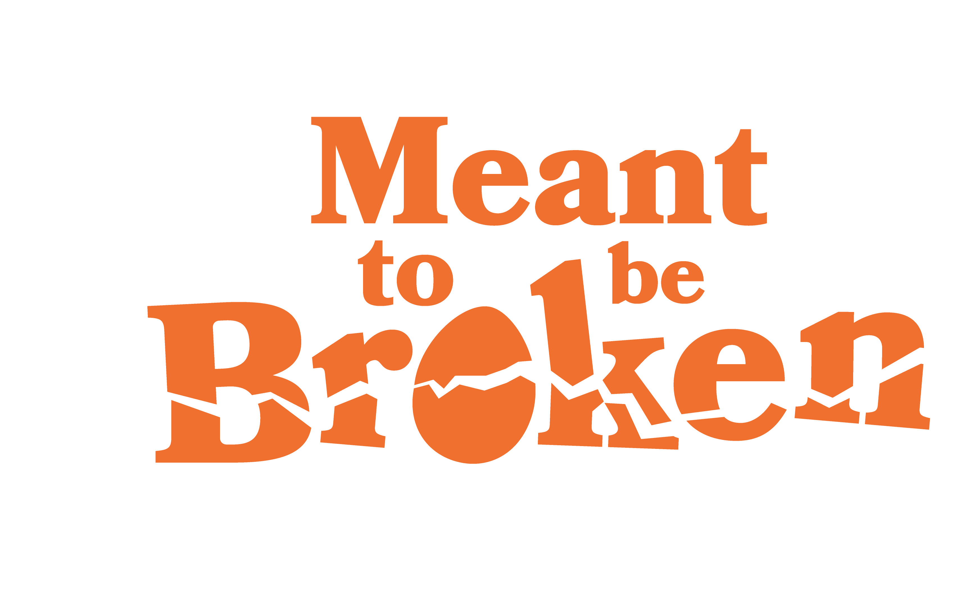
Videos

Slide 4
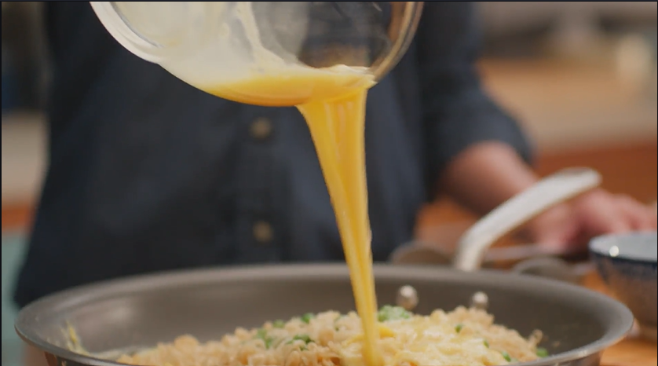
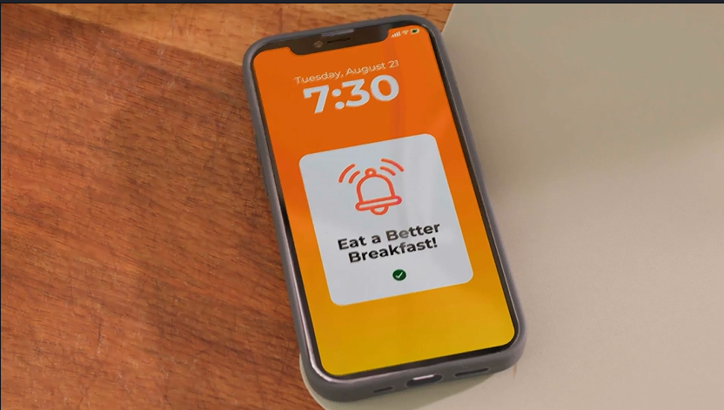
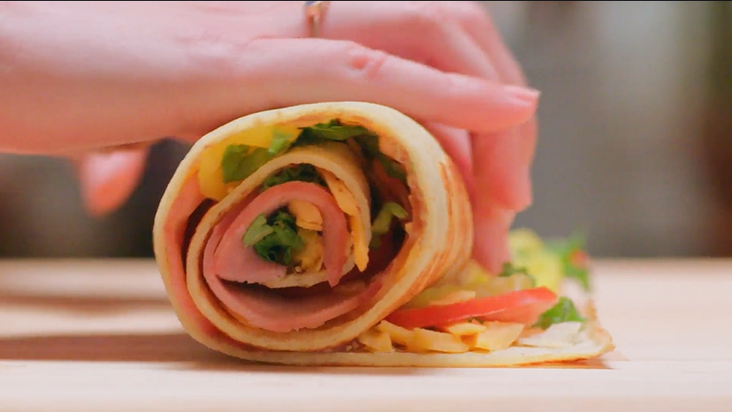
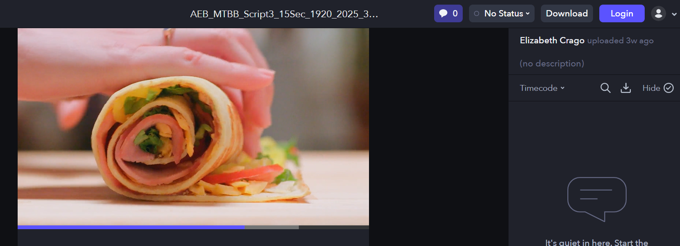
MTBB 2025: 15 Second Videos
“How to Fix Dinner”
“How to Make Mornings”
“How to Handle Hunger”
Vimeo player link
16x9 download link
1x1 download link
1x1 open caption download link
Vimeo player link
16x9 download link
1x1 download link
1x1 open caption download link
Vimeo player link
16x9 download link
1x1 download link
1x1 open caption download link
How to download: Use top right “download” button to download an MP4 file locally

Slide 5
Digital Ads

Slide 6
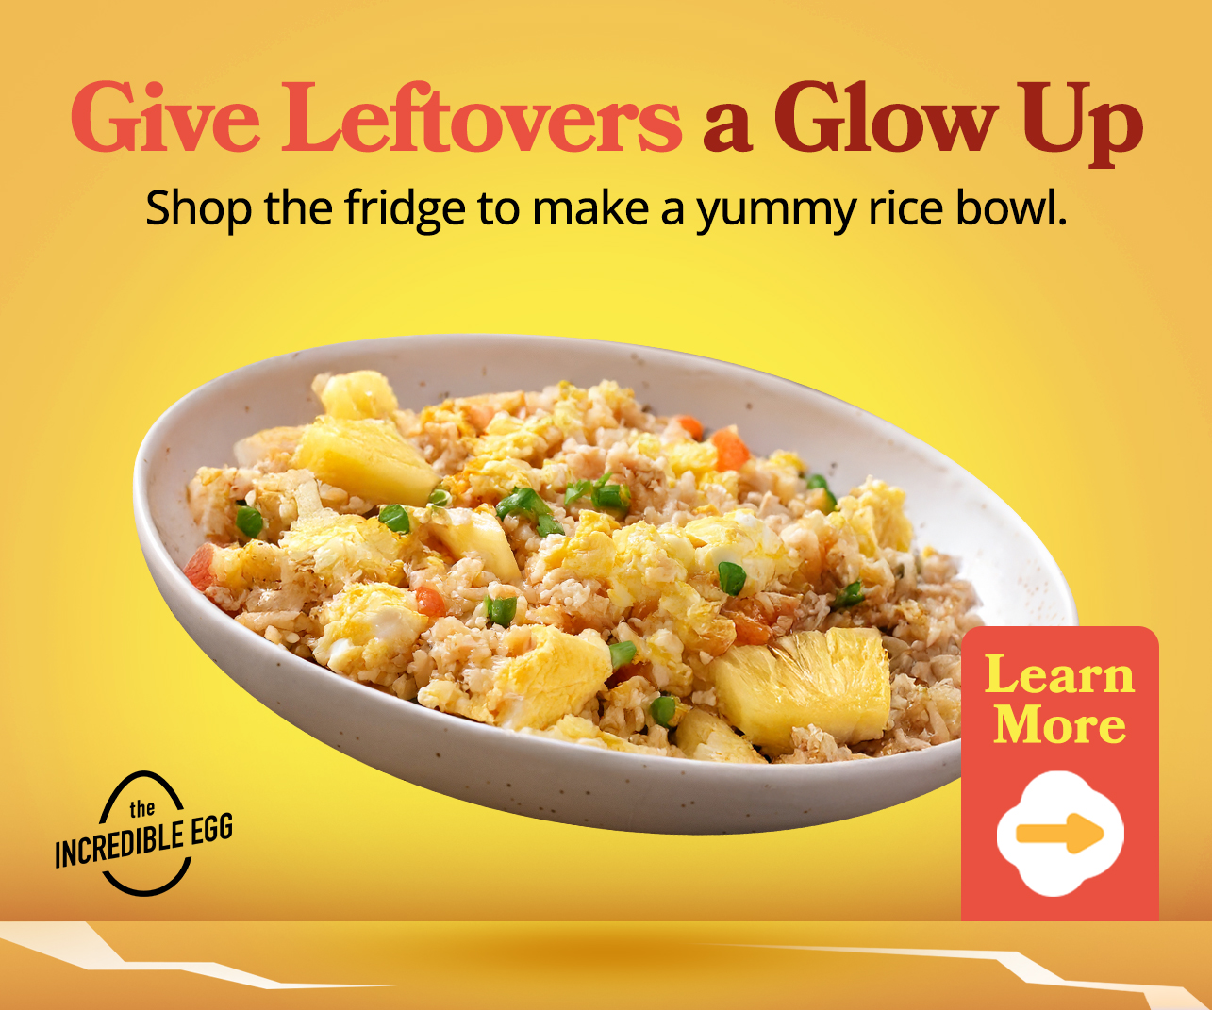




MTBB 2025: Digital Ads
Objective: Awareness Destination URL: https://meanttobebroken.org/
Sizes: 160x600, 300x250, 300x600, 610x200, 728x90
Download link HERE

Slide 7
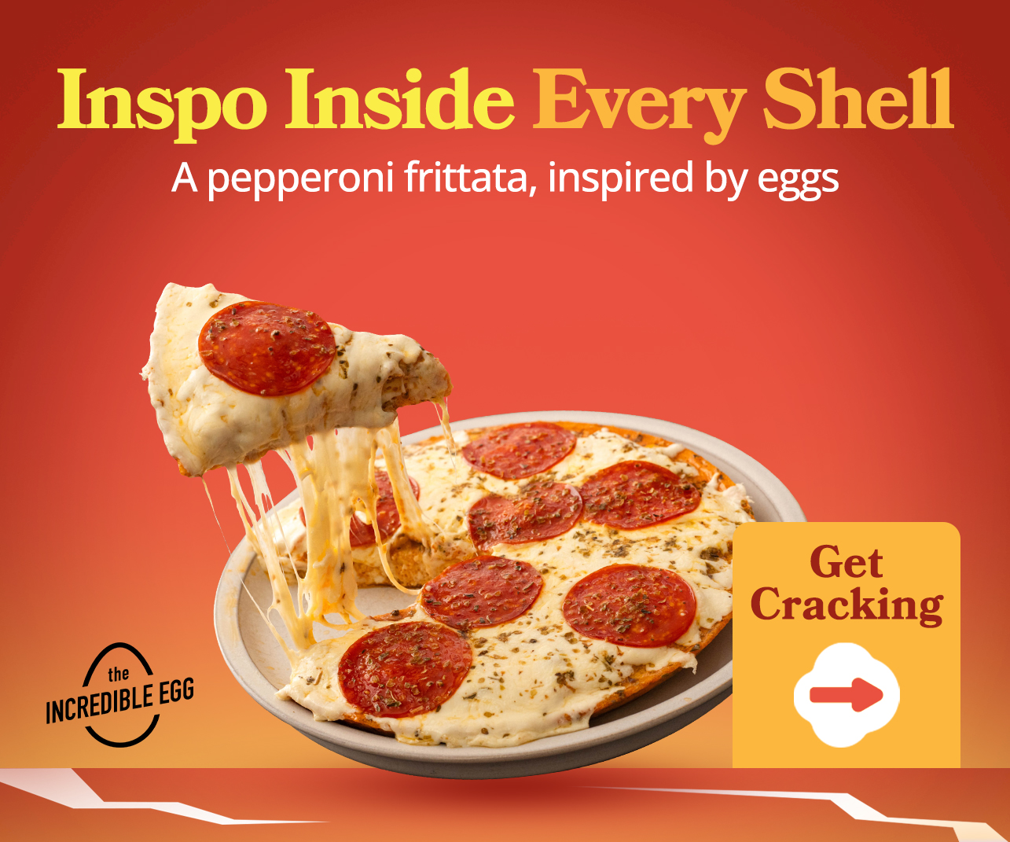

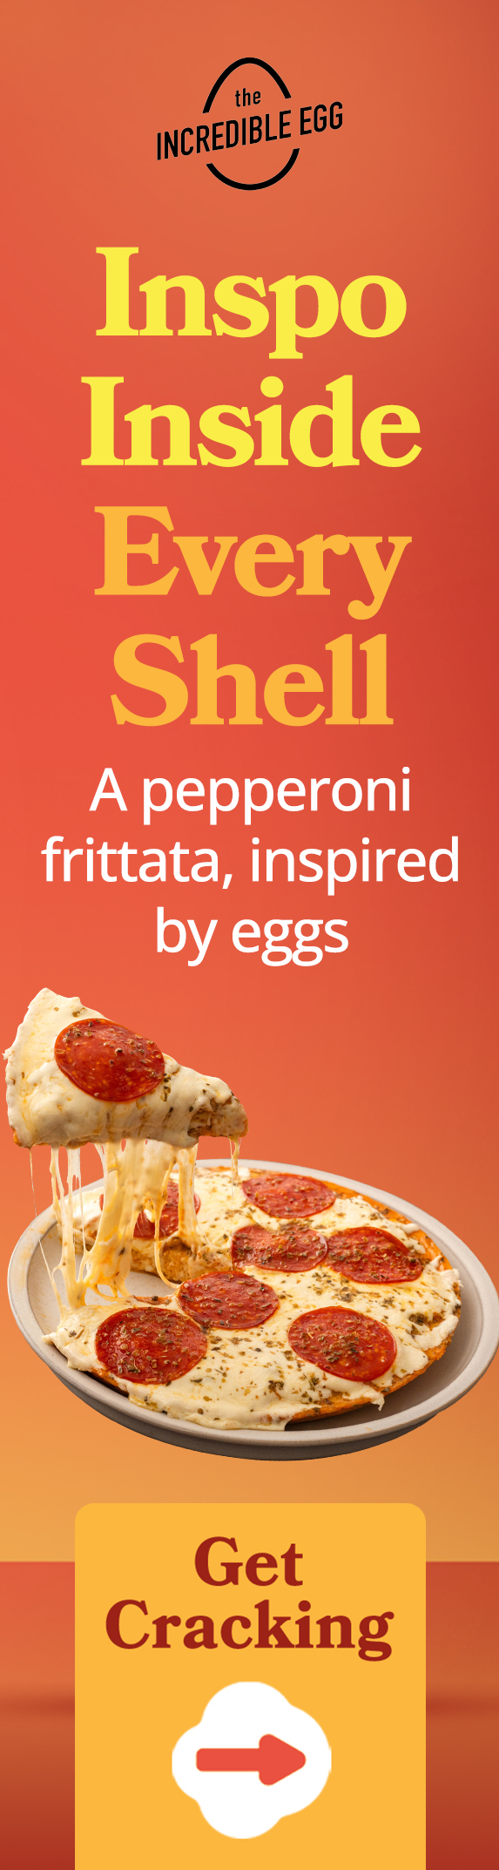
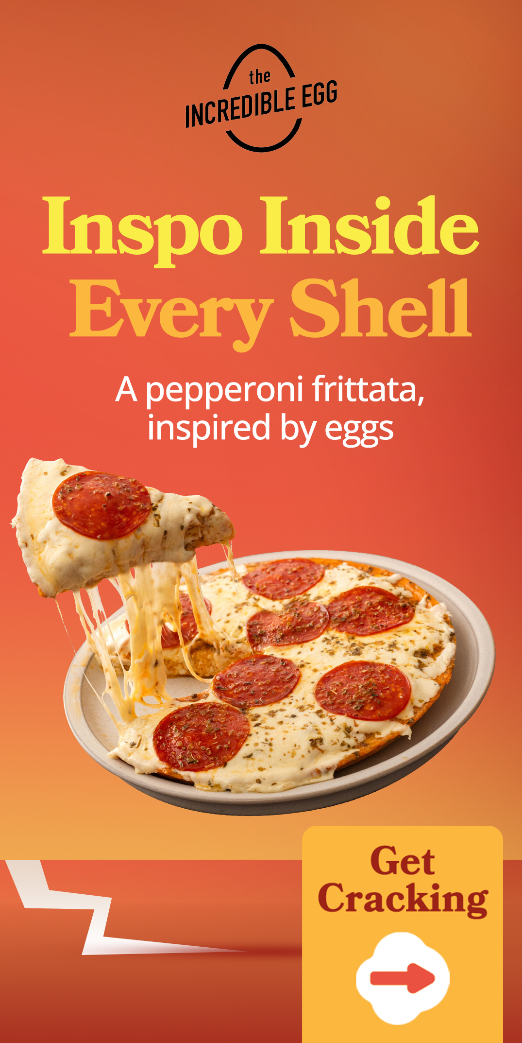
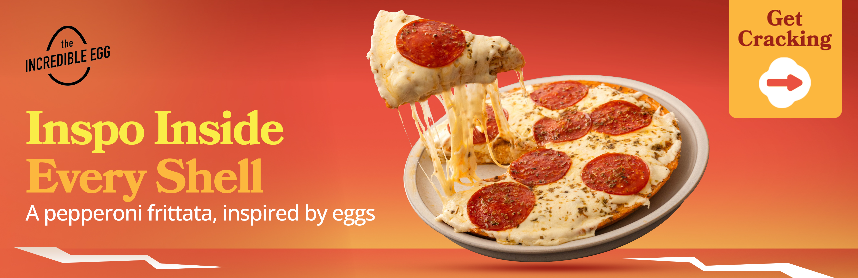
MTBB 2025: Digital Ads
Objective: Awareness Destination URL: https://meanttobebroken.org/
Sizes: 160x600, 300x250, 300x600, 610x200, 728x90
Download link HERE

Slide 8
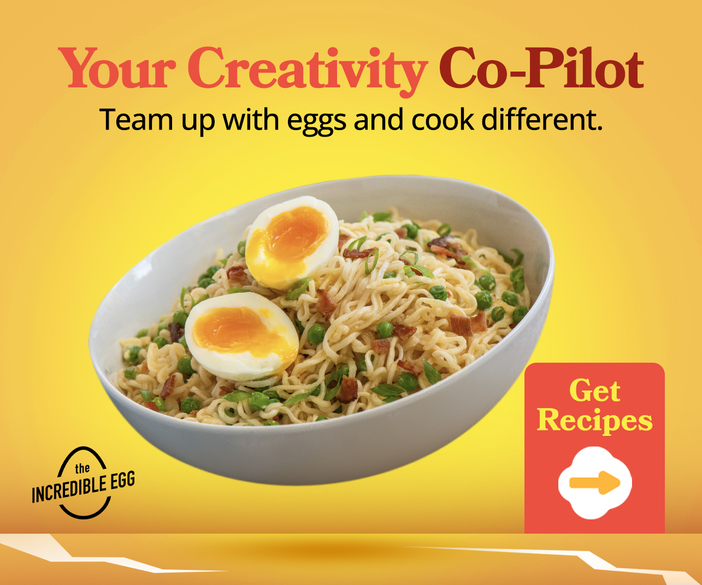




MTBB 2025: Digital Ads
Objective: Interest Destination URL: https://meanttobebroken.org/#recipes Sizes: 160x600, 300x250, 300x600, 610x200, 728x90
Download link HERE

Slide 9
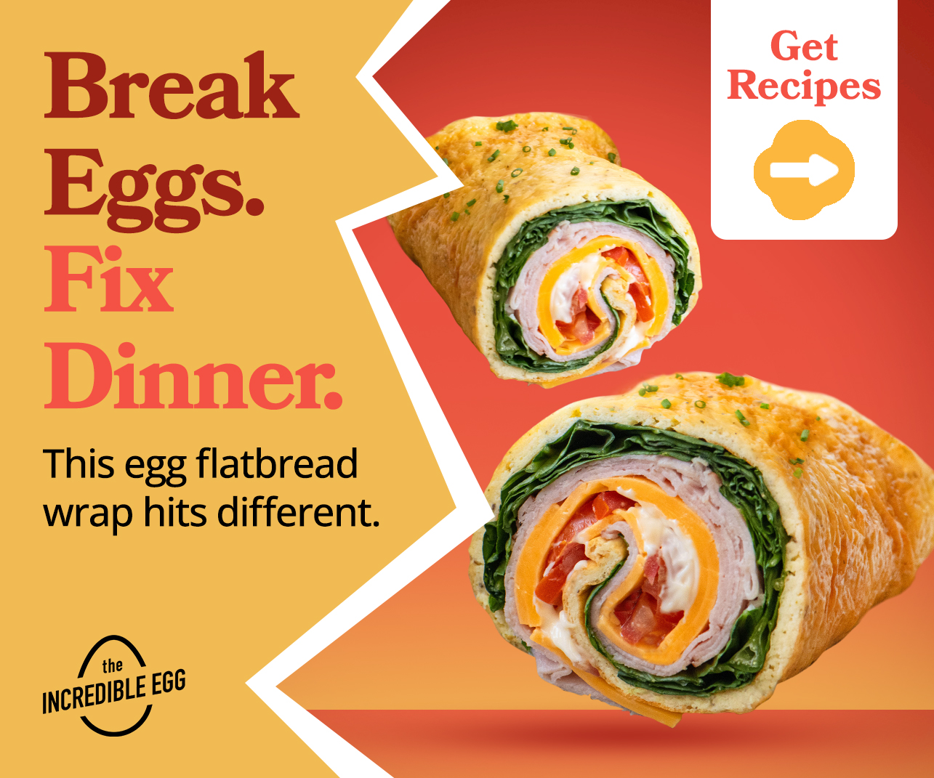




MTBB 2025: Digital Ads
Objective: Interest Destination URL: https://meanttobebroken.org/#recipes Sizes: 160x600, 300x250, 300x600, 610x200, 728x90
Download link HERE

Slide 10





MTBB 2025: Digital Ads
Objective: Intent Destination URL: https://meanttobebroken.org/egg-flatbread-wrap/
Sizes: 160x600, 300x250, 300x600, 610x200, 728x90
Download link HERE

Slide 11
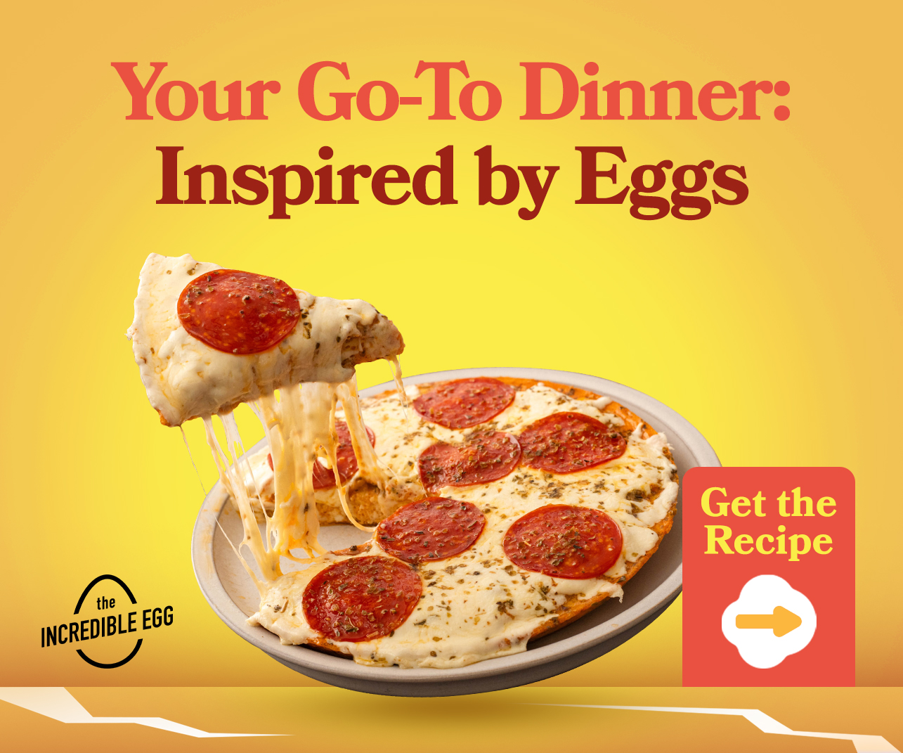


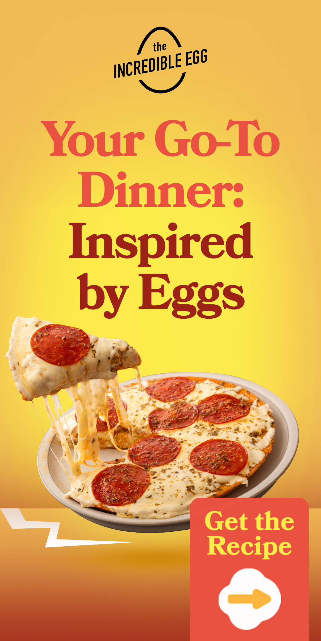

MTBB 2025: Digital Ads
Objective: Intent Destination URL: https://meanttobebroken.org/pepperoni-pizza-frittata/
Sizes: 160x600, 300x250, 300x600, 610x200, 728x90
Download link HERE

Slide 12



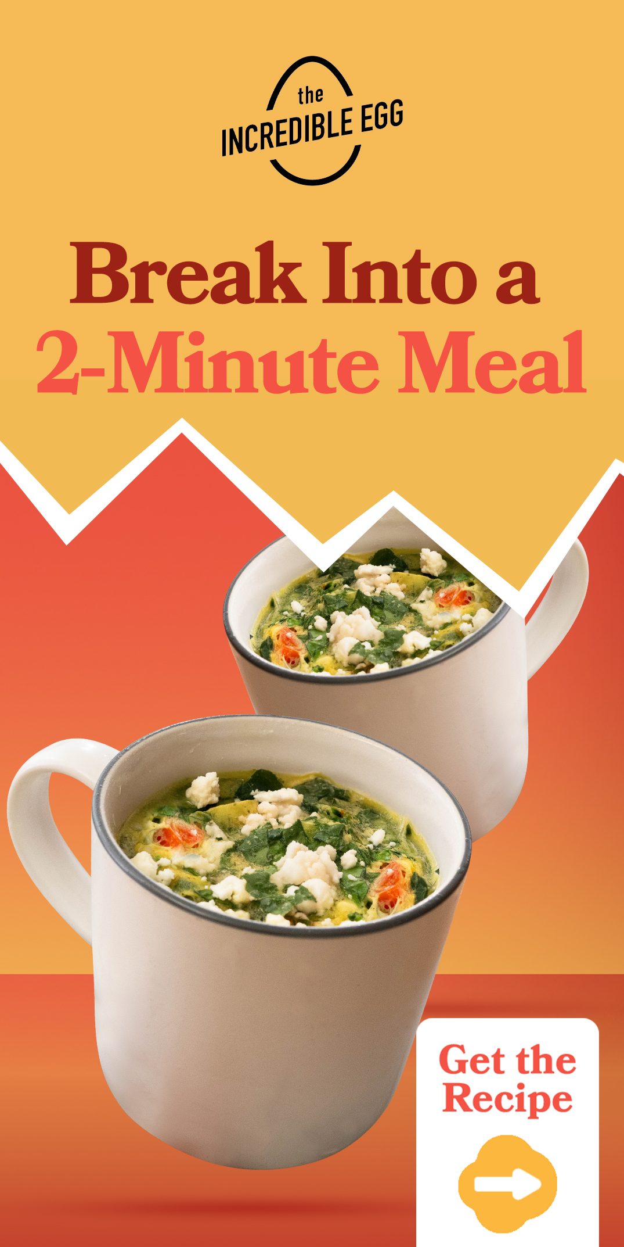

MTBB 2025: Digital Ads
Objective: Intent Destination URL: https://meanttobebroken.org/spinach-feta-mug-scramble/ Sizes: 160x600, 300x250, 300x600, 610x200, 728x90
Download link HERE

Slide 13
Social Videos
Best for use on Meta platforms (Instagram & Facebook)

Slide 14
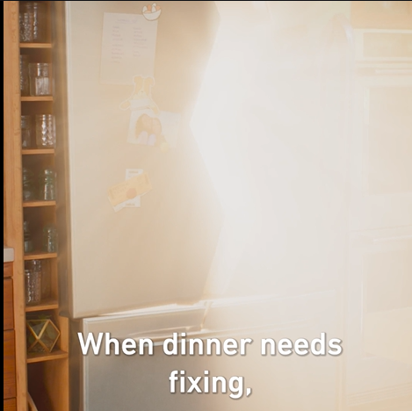
MTBB 2025: Social Videos (Meta) with Caption Options
Video Asset: How to Fix Dinner, 1x1 with captions (download here)
Destination URL: https://meanttobebroken.org/
Caption 1 (Campaign): Eggs make experimenting in the kitchen easy. Get the best tips, inspo and recipes to fix dinner.
Headline (23/27): Fix dinner. Break eggs.
Description (27/27): Eggs are meant to be broken
Caption 2 (Spot-specific): When dinner needs fixing, break out the eggs. Make a new dish that’s sure to satisfy, one crack at a time.
Headline (21/27): Get inspo and recipes
Description (27/27): Try a yummy Ramen Carbonara
Caption 3 (Inspiration): Eggs and a little inspo are all you need to fix dinner. Get cracking to get started.
Headline (27/27): Try a yummy Ramen Carbonara
Description (27/27): Eggs are meant to be broken
Caption 4 (Recipe Specific): Fix dinner your way. Use whatever’s on hand and make it into so much more, like this Ramen Carbonara.
Headline (27/27): Eggs are meant to be broken
Description (21/27): Get inspo and recipes
*Note: For posting organically on Meta channels, you will only need the caption and the destination URL. The headline & description were written for paid boosting.

Slide 15
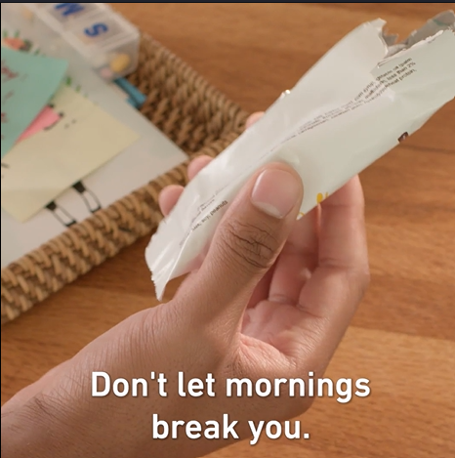
MTBB 2025: Social Videos (Meta) with Caption Options
Video Asset: How to Make Mornings, 1x1 with captions (download here)
Destination URL: https://meanttobebroken.org/
Caption 1 (Campaign): Go on, experiment with a different kind of morning. Because eggs are meant to be broken.
Headline (27/27): It’s giving endless options
Description (21/27): Get inspo and recipes
Caption 2 (Spot-specific): Don’t let mornings break you — break eggs instead. These air fryer egg bites make mornings a win.
Headline (27/27): Eggs are meant to be broken
Description (21/27): Get inspo and recipes
Caption 3 (Inspiration): Busy mornings can get the best of us. The answer: break things up and get inspired with eggs.
Headline (21/27): Get inspo and recipes
Description (20/27): Experiment with eggs
Caption 4 (Recipe Specific): Use up leftover veggies in these tasty Air Fryer Egg Bites, great for busy, on-the-go mornings.
Headline (25/27): Reclaim the day with eggs
Description (27/27): Eggs are meant to be broken
Note: For posting organically on Meta channels, you will only need the caption and the destination URL. The headline & description were written for paid social media ads.

Slide 16
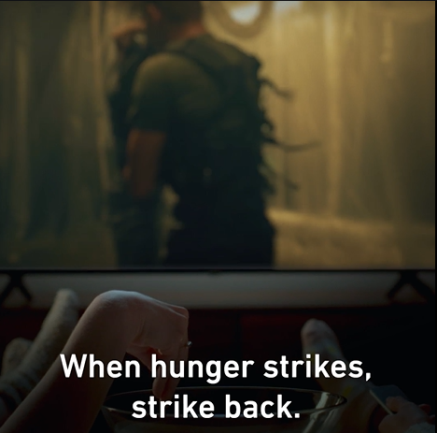
MTBB 2025: Social Videos (Meta) with Caption Options
Video Asset: How to Handle Hunger, 1x1 with captions (download here)
Caption 1 (Campaign): When you crack an egg, you open up endless inspiration and versatility. Try something new and see how good it can get.
Headline (20/27): How to handle hunger
Description (26/27): Egg-based flatbread recipe
Caption 2 (Spot-specific): When hunger strikes, strike back. Eat what you want, when you want with this infinitely flexible egg-based flatbread.
Headline (20/27): How to handle hunger
Description (27/27): Get cracking with egg inspo
Caption 3 (Inspiration): Anytime you’re hungry is the perfect time to reach for eggs. Get recipes and inspo that hit different.
Headline (23/27): Hungry? Break some eggs
Description (26/27): Egg-based flatbread recipe
Caption 4 (Recipe Specific): Swap out tortillas with an Egg Flatbread Wrap. This protein-powered flatbread is a great canvas for endless combinations.
Headline (23/27): Fix hunger. Break eggs.
Description (21/27): Get inspo and recipes
Note: For posting organically on Meta channels, you will only need the caption and the destination URL. The headline & description were written for paid social media ads.

Slide 17
Recipes & Photos

Slide 18
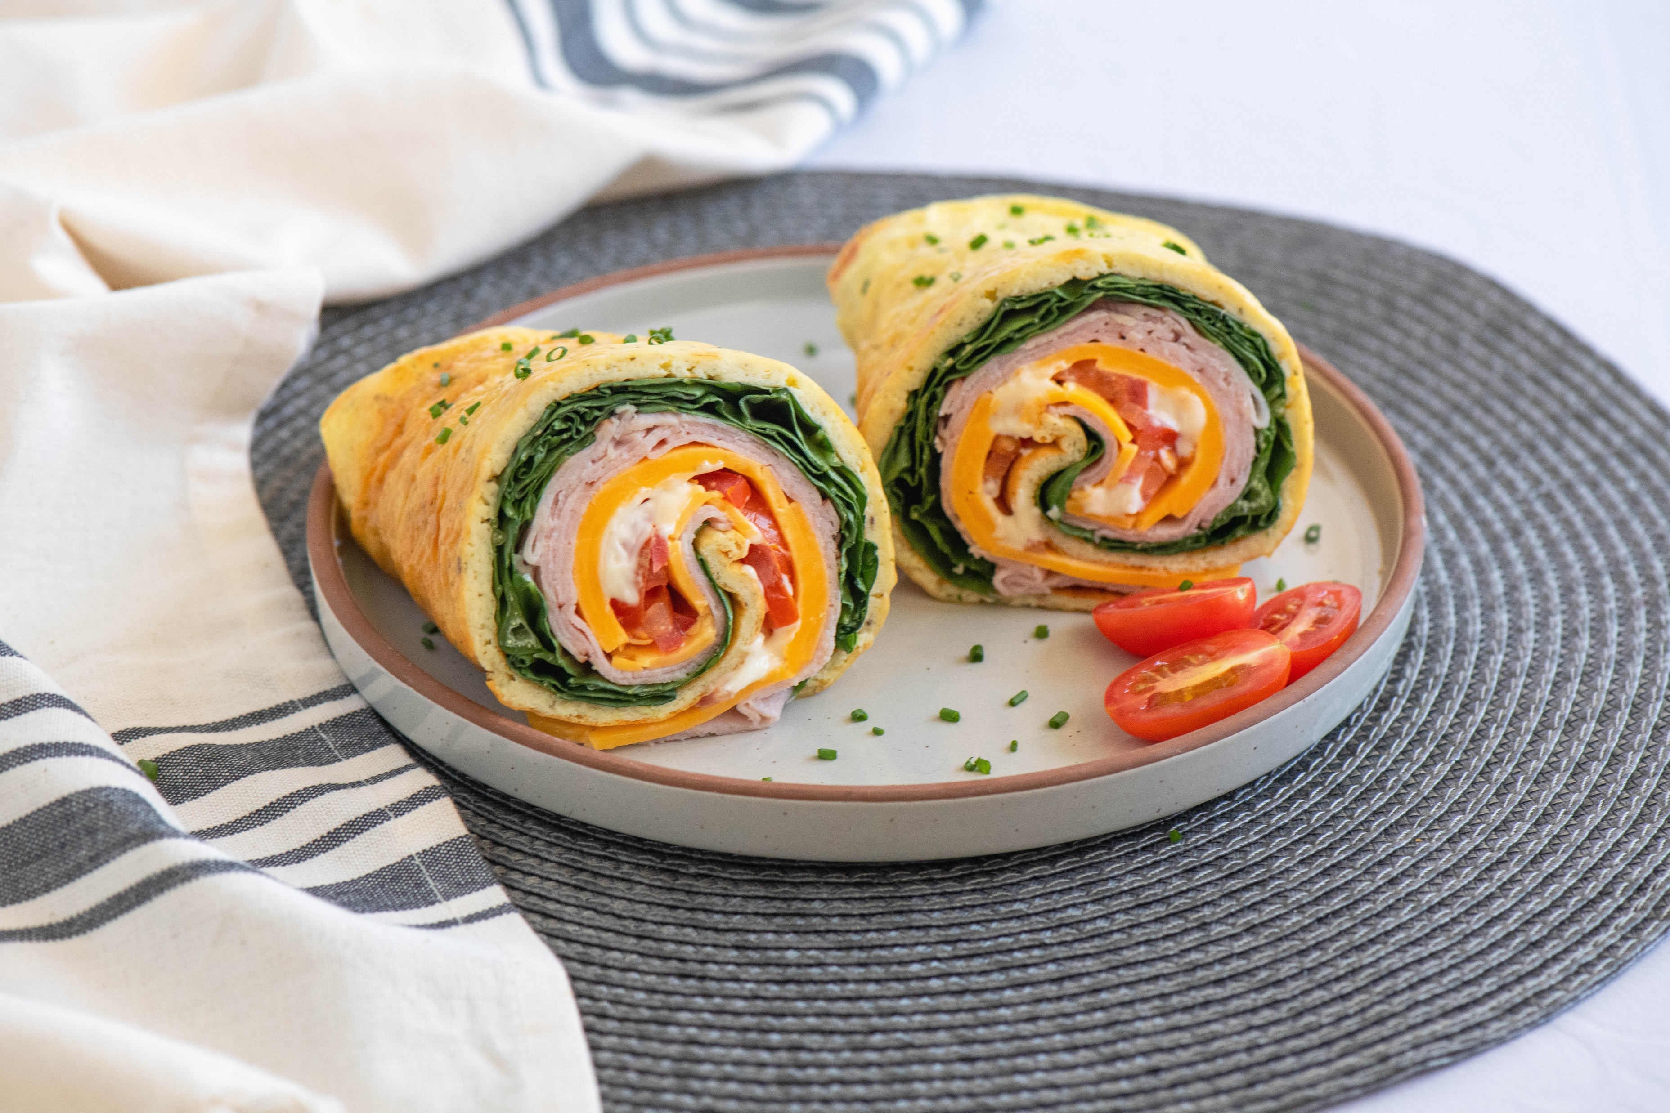
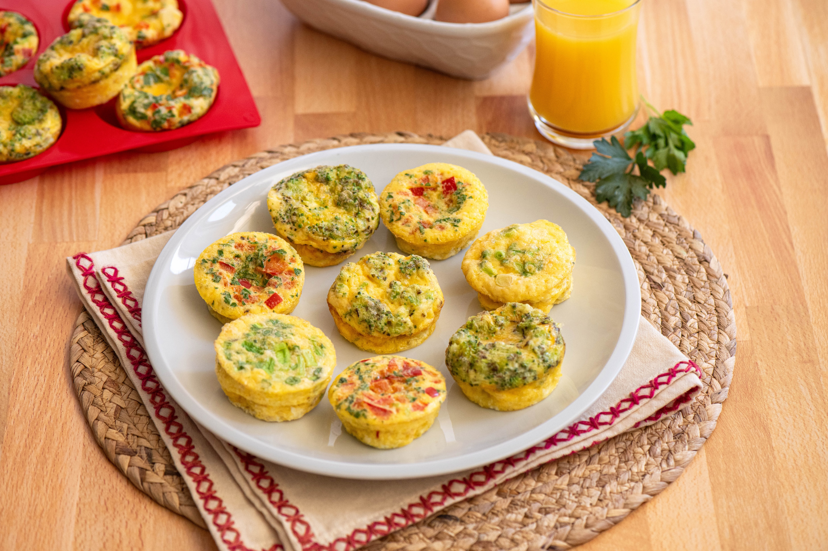
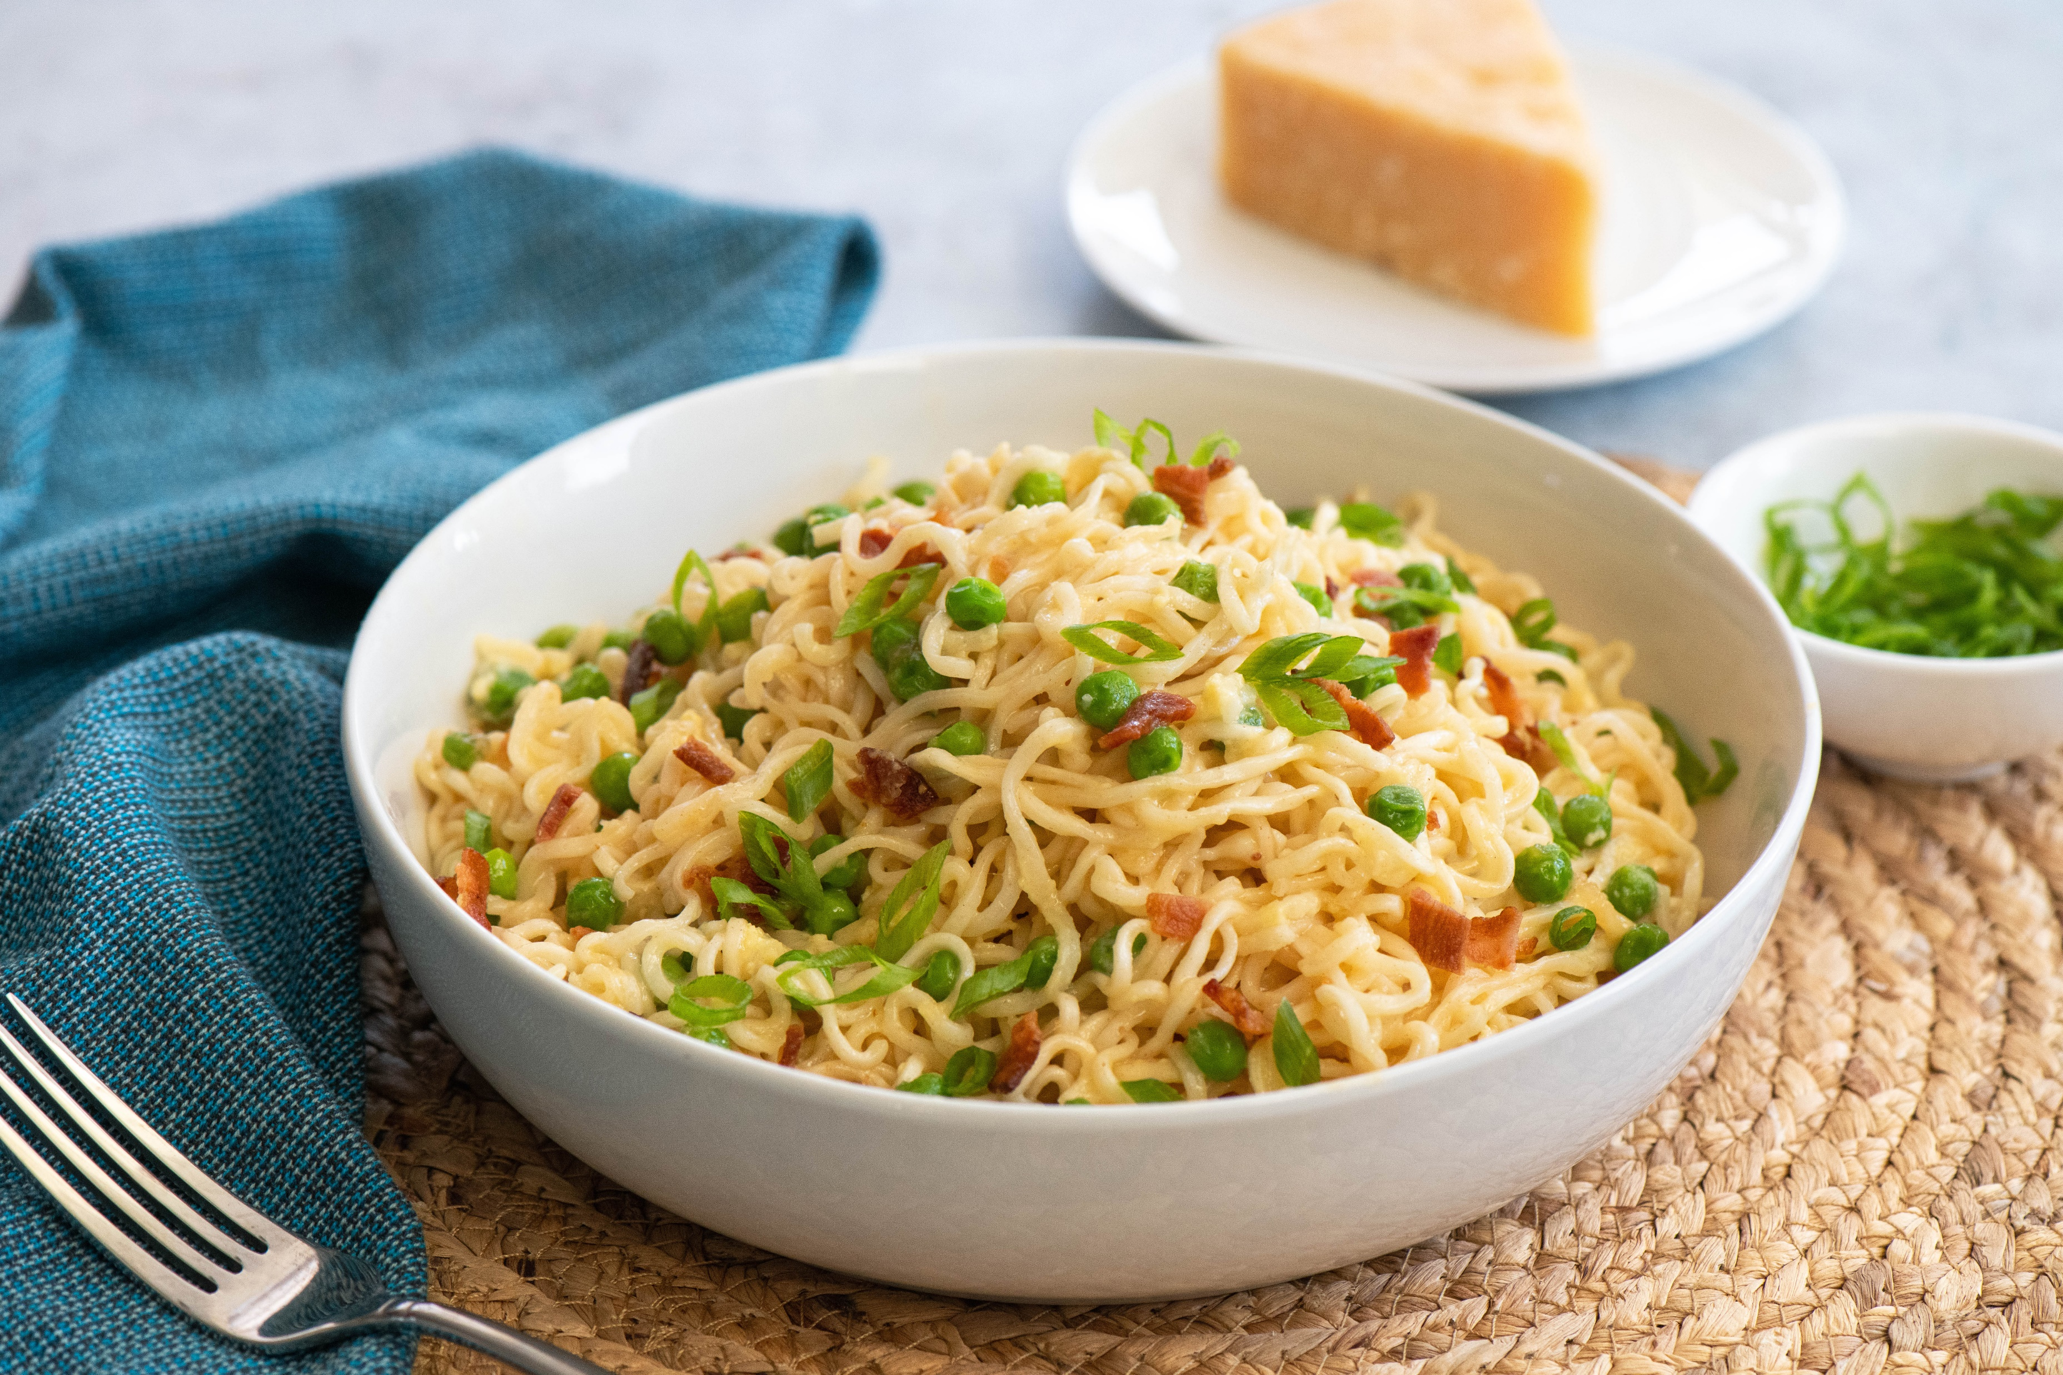
MTBB 2025: Hi-Res Photos & Links to Recipe Instructions
Egg Flatbread Wrap - American Egg Board
Air Fryer Egg Bites - American Egg Board
Ramen Carbonara - American Egg Board

Slide 19
Social Posts
Best for use on Meta platforms
(Instagram, Facebook)

Slide 20
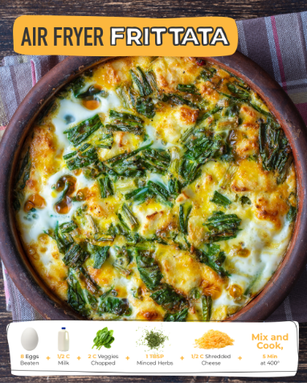
Make Your Ingredients Go Further
Channel | Copy | Image
Instagram | Meet your new favorite easy air fryer recipe: frittatas. 🙌🍳 How to make it: 1. Line the basket with parchment paper and trim corners. Center the sheet in the basket. Leave enough height to hold the ingredients. 2. Whisk the eggs and milk in a medium bowl. 3. Add chopped veggies, minced herbs, and shredded cheese to egg mixture. Mix well. 4. Pour into basket and cook for 5 minutes at 400°. 5. Let cool for 5 minutes and serve. 😋 Want to try it out? Screenshot this post and save it for later! #airfryer #completeprotein #MeantToBeBroken For food safety, always ensure eggs are cooked to 160 F.
Facebook | Meet your new favorite easy air fryer recipe: frittatas. 🙌🍳 How to make it: 1. Line the basket with parchment paper and trim corners. Center the sheet in the basket. Leave enough height to hold the ingredients. 2. Whisk the eggs and milk in a medium bowl. 3. Add chopped veggies, minced herbs, and shredded cheese to egg mixture. Mix well. 4. Pour into basket and cook for 5 minutes at 400° F. 5. Let cool for 5 minutes and serve. 😋 For food safety, always ensure eggs are cooked to 160° F. Screenshot this post to try it yourself!

Slide 21
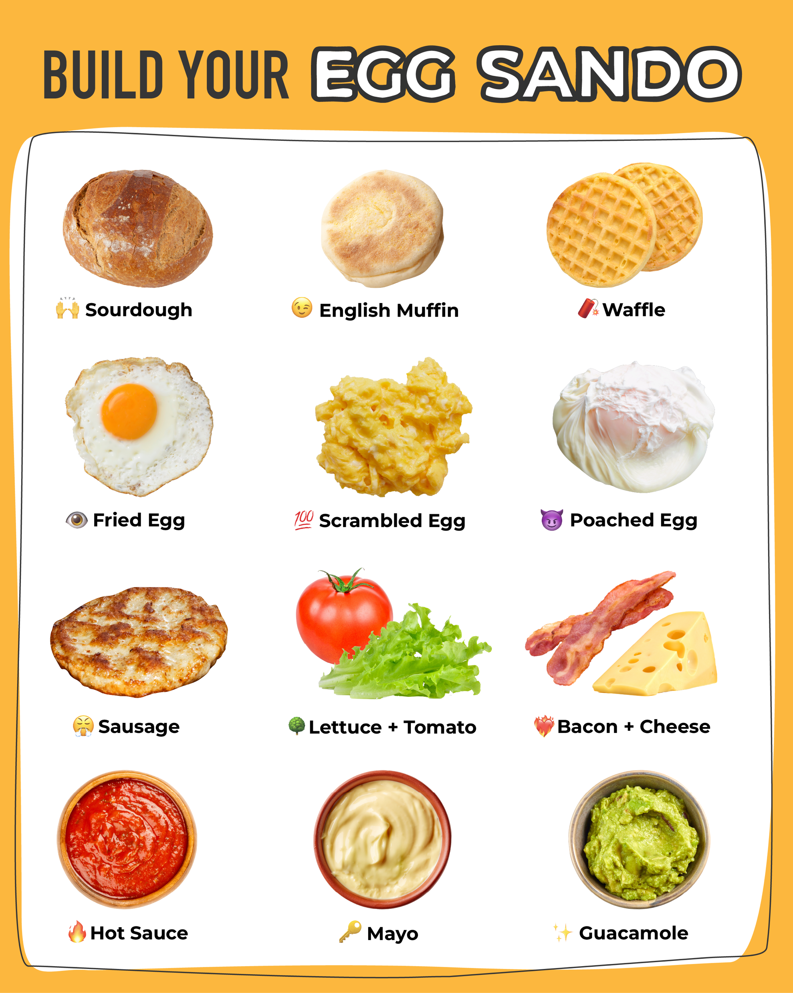
On-the-Go Egg Solutions
Channel | Copy | Image
Instagram* | What’s your dream egg sandwich for a summer picnic? Personally, we could really go for a 🧨💯❤️‍🔥🔥 right now. 😋 #recipes #onthego #MeantToBeBroken
Facebook* | There are so many on-the-go egg recipes you can create from so few ingredients. What’s your dream egg sandwich for a summer picnic? Personally, we could really go for a 🧨💯❤️‍🔥🔥 right now. 😋
*Note: Adjust copy as needed to align with post timing.
For example: In place of “summer picnic” it could be an “after-school snack” or “WFH lunch.”

Slide 22

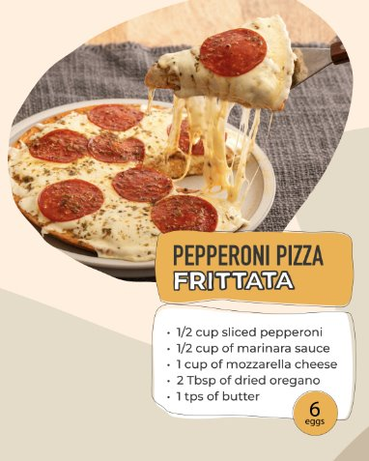
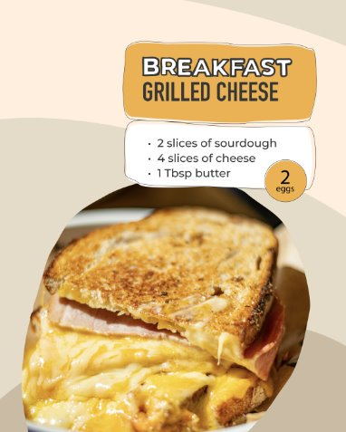
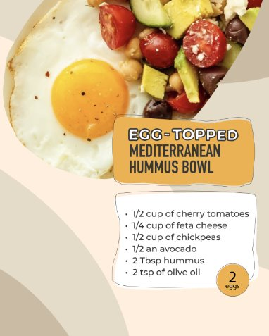
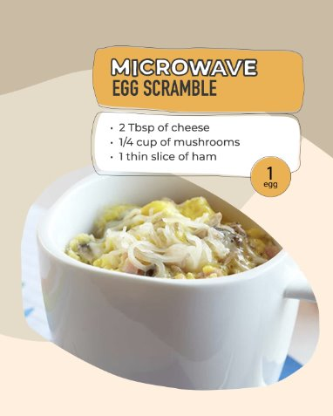
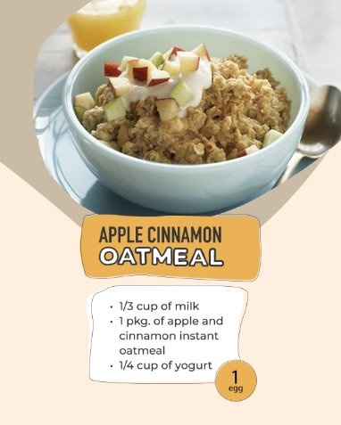
Ways to Use a Carton
Channel | Copy
Instagram | Bet you didn’t know about #5… 👀​ #MeantToBeBroken #eggs #recipeideas #budgetcooking #mealinspo #easymealideas
Facebook | These 5 recipes prove eggs aren’t just for breakfast—they’re for every meal, snack, and craving in between. 🍳✨ Follow us for more creative, delicious meal ideas that make your eggs work harder (and smarter).

Slide 23
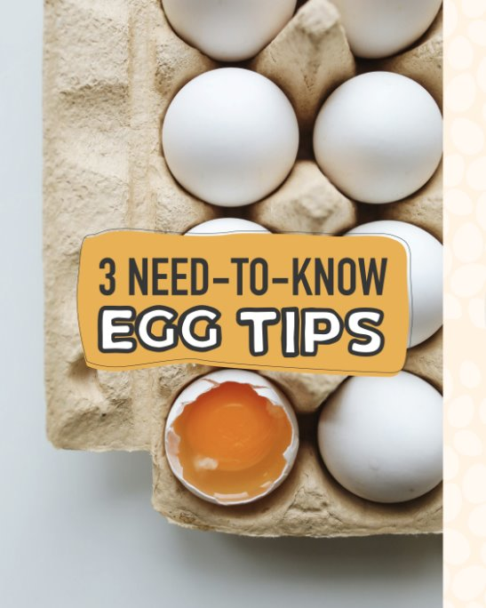
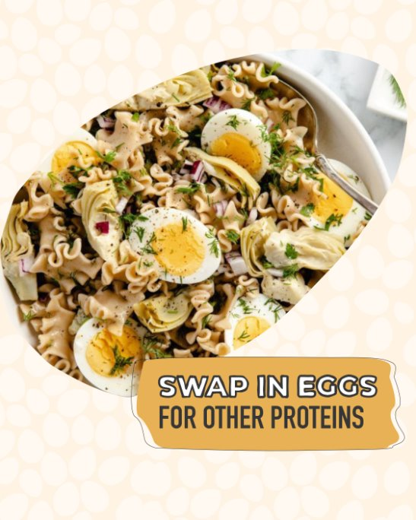
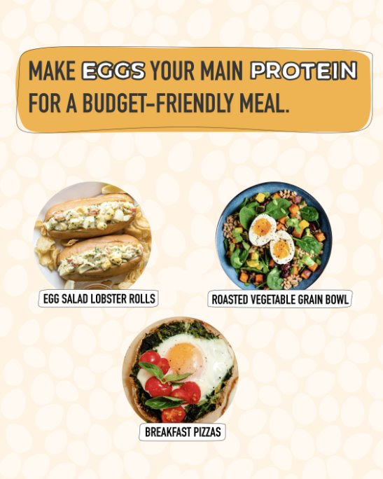


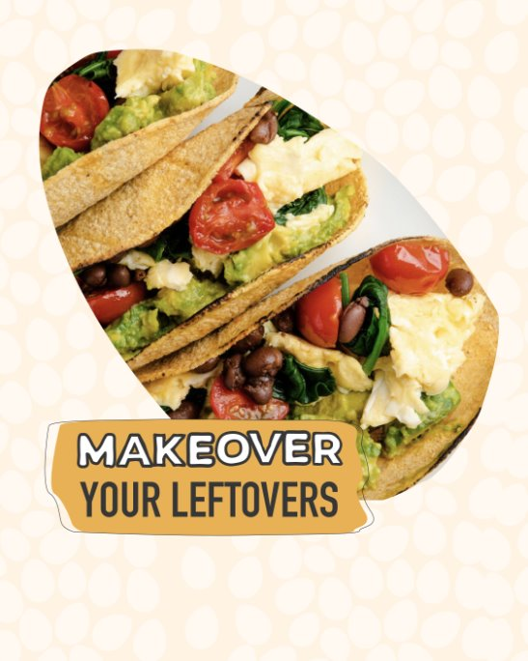
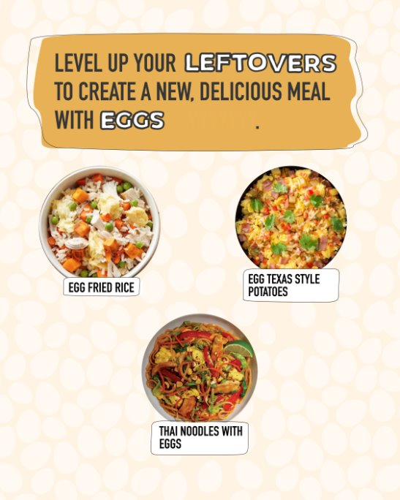
Egg Tips
Channel | Copy
Instagram | Swap, freeze, level up. If you don't know what this means, then you might want to save these helpful egg meal prep tips. 🙌​ #MeantToBeBroken #mealprep #eggs #recipes ​ ​
Facebook | Expand your meal prep portfolio with these key tips on how and when to use your eggs. Your next great recipe idea could already be in your kitchen! ✨🥚

Slide 24
LinkedIn Posts

Slide 25
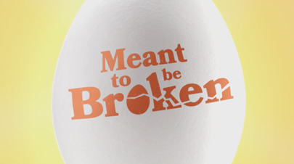
LinkedIn
Channel | Copy | Suggested Image
LinkedIn | [Insert farm name/state org name], with America's egg farmers and the American Egg Board, is on a mission to change how people view and use eggs. Every egg is a perfect little package of amazing potential—when you break an egg, you're breaking into endless inspiration, versatility, and convenience. Click the link below learn how to break out of your cooking routine and unlock the endless potential of this kitchen superhero! Meanttobebroken.org
LinkedIn | Eggs have long been seen as just a staple, but [Insert farm name/state org name] knows they're so much more than that. A solution you can feel confident in, eggs are a blank canvas for culinary creativity. Break into inspiration—and a few eggs—today! Meanttobebroken.org
LinkedIn | Great things happen when you break the mold—and a few eggs. Every egg holds infinite potential waiting to be unleashed. From a surprising dinner hack to a quick, nutritious breakfast, eggs are the versatile kitchen superhero we've all been searching for. A single shell holds infinite possibilities! [Insert farm name/state org name] is encouraging everyone to express themselves through new creations, step out of their kitchen comfort zones, and embrace the versatility of eggs. And if you need inspiration, we've got ideas by the dozen. Meanttobebroken.org

Slide 26
Hashtags

Slide 27
MTBB 2025: Hashtags
What are hashtags?
Hashtags are keywords or phrases on social media, preceded by the "#" symbol, to categorize content and make it easily discoverable. They help users find posts related to specific topics, join conversations, and engage with communities. By using relevant hashtags, individuals and brands can increase their visibility, reach a wider audience, and boost engagement on their posts.
Campaign Hashtags
#MeanttobeBroken #BreakSomeToday #BreakIntoACarton #BreakSomeEggs
HASHTAG BEST PRACTICES
Keep tags relevant
Avoid hashtags that don't relate to what you're sharing.
With Instagram's indexing feature, use SEO key search terms to inform relevant hashtag selections and make content more discoverable in search.
Use the right amount
For Instagram and TikTok, 4-5 hashtags is the maximum recommended.
Avoid overuse
Using more than the ideal number of hashtags noted above can make a post seem spammy or inauthentic.

Slide 28
Questions?
AEB is here to support your marketing needs. We can provide you with a variety of marketing assets from this tool kit to additional recipes, graphics and social media support.
For help with any requests, please reach out to:
Sue Coyle
Director of Integrated Marketing
scoyle@aeb.org

